Slide 1


0: Confirming Tic-Tac-Toe
Prof. Muise

Slide 2
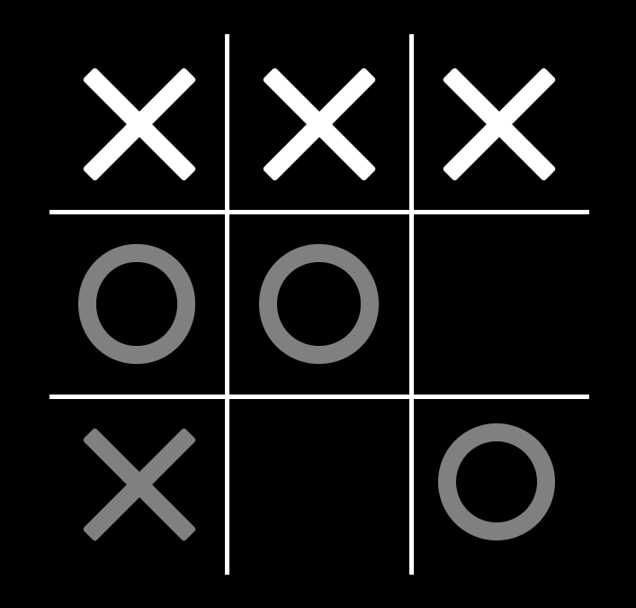
Summary
Everyone knows that tic-tac-toe is the pinnacle of AI applications. This project aims to assess if player x has won the game.
A model will correspond to the positions of the x marks that make up a line in the game. If no such model exists, then it means x has yet to win.

Slide 3
Propositions
x_{ij}: This is true with position (i,j) has an x mark in it.
E.g., x₁₁, x₁₂, x₁₃, x₃₁ would all be true in the figure to the right.
r_{i}: This is true when row i is a winning row.
E.g., r₁ would be true in the figure on the right.
c_{i}: Similar to row propositions, but for columns.
d_{i}: Similar to row propositions, but for diagonals (1 and 2)

Slide 4
Constraints
We only want the model to describe one winning configuration:
r₁ ∨ r₂ ∨ …
(¬r₁ ∨ ¬r₂) ∧ (¬r₁ ∨ ¬r₃) ∧ …
A row proposition holds only when the x marks are there:
r_{i} ↔ (x_{i1} ∧ x_{i2} ∧ x_{i3})
Same for columns and diagonals
We start with an initial board configuration
x₁₁ ∧ x₁₂ ∧ x₁₃ ∧ ¬x₂₁ ∧ ¬x₂₂ ∧ ¬x₂₃ ∧ x₃₁ ∧ ¬x₃₂ ∧ ¬x₃₃

Slide 5
End

